Slide 1
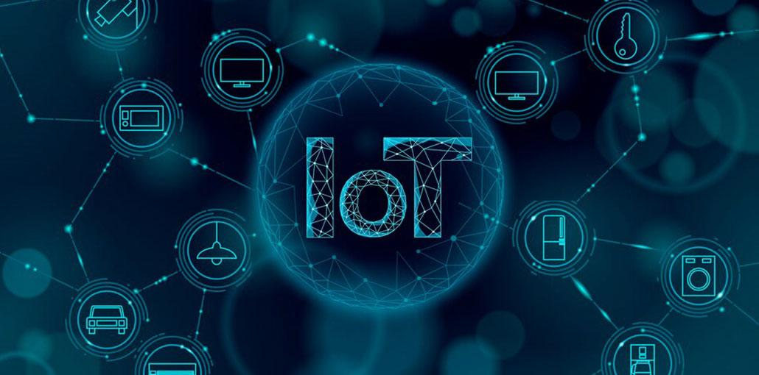
Protocols for Internet of Things

Slide 2

D Y Patil College of Engineering, Akurdi, Pune
An Autonomous Institute from AY 2024-25, Affiliated to Savitribai Phule Pune University,
B Tech in E & TC Engineering | S Y B Tech Semester IV (2024 COURSE)
Course Category-Multidisciplinary Minor
Course Code- ET124MD406
Course Title- Protocols for Internet of Things
Faculty Name- Mrs. Sayali Mane

Slide 3
IoT Protocols Part - 1
UNIT 2
By Mrs. Sayali Mane

Slide 4
CO-PO Mapping
Course Outcome (CO) | Bloom's Level | After successful completion of the course learner will be able to: | PO Mapping
CO2 | L4 (Analyze) | Analyze and compare different communication models based on specific parameters. | PO (1, 2, 3, 4, 5, 6, 7, 8, 9, 10, 11)
Program Outcomes (POs)
1. Engineering knowledge
2. Problem analysis
3. Design/development of solutions
4. Conduct investigations of complex problems
5. Modern tool usage
6. The engineer and society
7. Environment and sustainability
8. Ethics
9. Individual and teamwork
10. Communication
11. Project management and finance
12. Lifelong learning

Slide 5
CONTENTS
PHY/MAC Layer: Wireless HART, ZWave, Bluetooth Low Energy,
Zigbee Smart Energy.
Network Layer: IPv4, IPv6, 6LoWPAN, ICMP,RPL, COAP

Slide 6
To understand how smart devices communicate and function together, learning about the Architecture of the Internet of Things (IoT) is essential. It defines how sensors, networks and cloud systems interact to collect, process and exchange data efficiently.
The IoT architecture acts as the foundation for all connected devices and applications.
Each layer has a distinct role, from sensing real-world data to delivering intelligent actions.
A clear structure ensures scalability, security and smooth device communication.
This architecture forms the backbone of IoT systems, powering everything from smart homes to industrial automation.At its core, IoT architecture is a framework or blueprint that defines how different parts of an IoT ecosystem—devices, networks, software, and users—interact with each other. It organizes the workflow of sensing, communicating, processing, and acting into structured layers.

Slide 7
The Internet of Things (IoT) is about the network of sensor devices to the web in real-time. IoT devices communicate with each other over the network, so certain standards and rules need to be set to determine how data is exchanged. These rules are called IoT Network Protocols. Depending on the IoT application's functionality, its workflow or architecture varies.
Basic architecture involves four layers, i.e., the Sensing layer, Network layer, Data processing layer, and Application layer.
The Sensing layer contains all the hardware, like sensors, actuators, chips, etc., that collect information. This layer is connected to the successive layer, which is the network layer, through protocols.
The Network layer allows communications among devices using network protocols like cellular, Wi-Fi, Bluetooth, Zigbee, etc.
The data collected by IoT devices is processed in the Data processing layer using technologies like data analytics and machine learning algorithms.
This processed data can be displayed to the user through web portals, apps, or interfaces provided by the application layer. Users can directly interact and visualize the data obtained from IoT devices through these interfaces.

Slide 8
Essential Requirements for Effective IoT Protocols
IoT protocols should also satisfy these requirements:
Allow communication among various devices simultaneously.
IoT is being used in critical areas like health, industries, home surveillance, etc. hence communication security needs to be ensured.
Transport data efficiently.
IoT devices can be added or removed from the IoT network. Hence protocols must provide scalability.
There are many such protocols developed for IoT, then how to choose one??
One way to decide which protocol to use is to consider the environment for which these protocols are designed. Some are designed for small ranges; some are for wide ranges, high data rates, low data rates, etc. They vary based on power consumption, range, cost, data rate, etc.

Slide 9
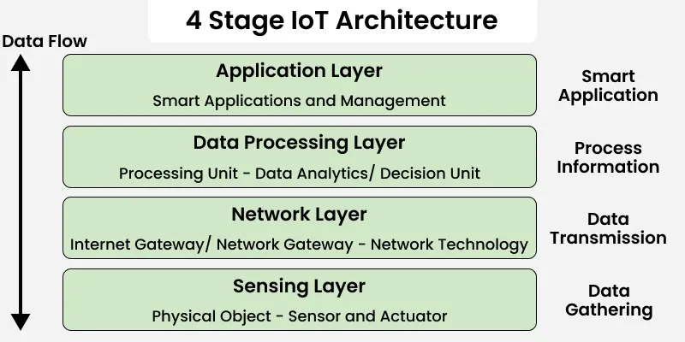

Slide 10
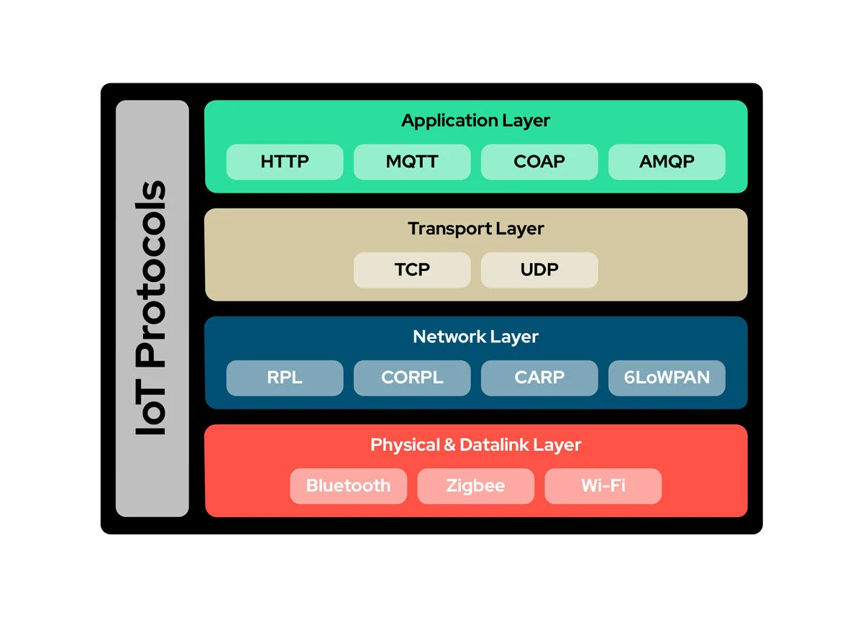

Slide 11
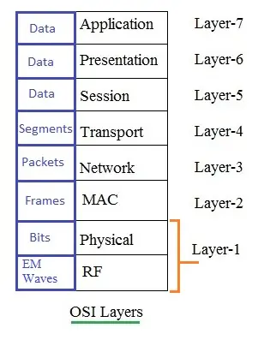
In the context of IoT (Internet of Things) networking, the PHY (Physical) layer and MAC (Media Access Control) layer are two fundamental layers of the OSI (Open Systems Interconnection) model that play crucial roles in enabling communication between devices. They represent different layers of the networking stack and serve distinct functions.
The PHY layer occupies the lowest layer-1 of OSI stack and handles the physical aspects of communication.
The MAC layer occupies the lowest layer-2 and manages access to the communication medium and ensures efficient and secure data transmission in IoT networks.
What is PHY Layer
PHY is the short form of Physical Layer. It is the layer-1 in OSI stack. It interfaces physical medium with MAC and upper layers. Physical medium can be copper wire, fiber optic cable, twisted pair or even wireless channel.
Function: The PHY layer is the lowest layer in the OSI model and is responsible for the physical transmission of raw bits over the communication medium. Following are the key responsibilities of PHY layer :
It converts MAC layer format suitable to be transported over the medium.
Defines the characteristics of the physical medium, such as cables, wireless channels, or optical fibers.
Converts digital data into analog signals for transmission and vice versa.
Incorporates modulation and demodulation functionalities which transforms bits into symbols and vice versa.
Specifies the data transfer rate and the encoding scheme used for transmitting data over the physical medium.
Provides error correction capability by using convolutional encoder or turbo encoder at transmit end and suitable decoder at the receive end.
Describes the physical connectors, pinouts, and electrical properties required for data transmission.

Slide 12
What is MAC Layer
MAC is the short form of Medium Access Control Layer. It is the layer-2 in OSI stack. It interfaces PHY layer and Upper layers (i.e. network and above).
Function: The MAC layer operates at a higher level than the PHY layer and is responsible for managing access to the shared communication medium. Following are the key responsibilities of MAC layer :
Addressing: Assigns unique MAC addresses to devices on the network for identification. MAC Header is added at the beginning of IP packet for this purpose.
Channel access: Controls how devices on the network gain access to the communication channel, especially in shared or wireless environments.
Frame formatting: Divides data into frames, adds addressing information, control bits, and error-checking, creating a structured format for transmission. CRC is added at the end of frame for error detection and retransmission.
Flow control: Manages the flow of data to ensure efficient communication between devices. This is achieved by segmentation (at transmit end) and re-assembly (at receive end).

Slide 13
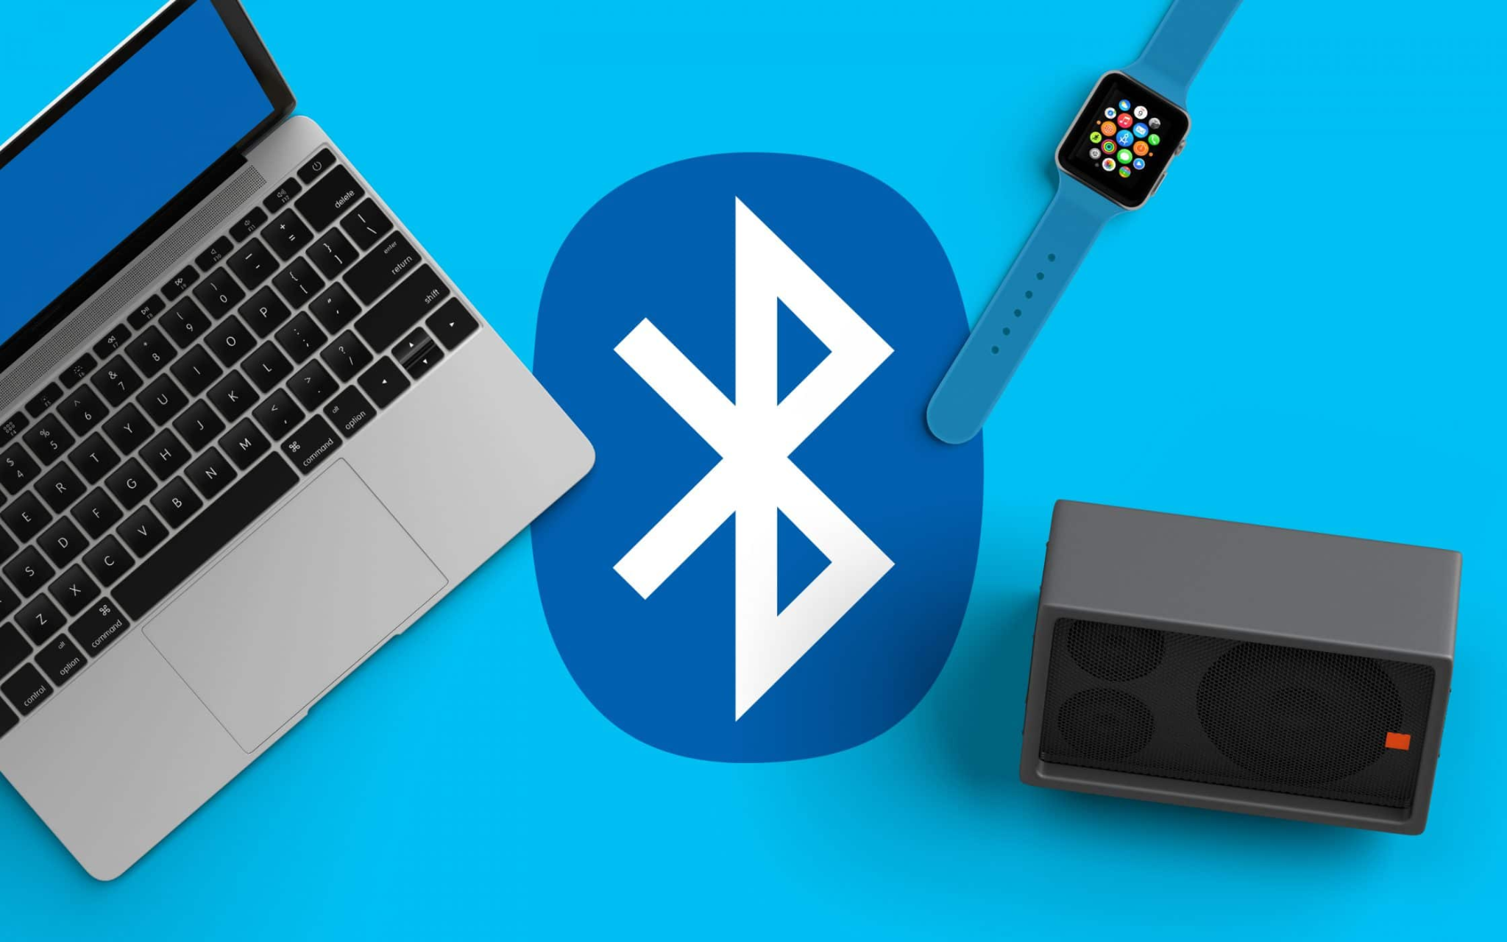
1.Bluetooth
Bluetooth is used for short-range wireless voice and data communication.
It is a Wireless Personal Area Network (WPAN) technology and is used for data communications over smaller distances.
This generation changed into being invented via Ericson in 1994.
It operates within the unlicensed, business, scientific, and clinical bands from 2.4 GHz to 2.485 GHz.
Bluetooth stages up to 10 meters. Depending upon the version, it presents information up to at least 1 Mbps or 3 Mbps.
A Bluetooth network is called a piconet and a group of interconnected piconets is called a scatter net.
Bluetooth is a wireless technology that lets devices like phones, tablets, and headphones connect to each other and share information without needing cables.
Bluetooth simply follows the principle of transmitting and receiving data using radio waves. It can be paired with the other device which has also Bluetooth but it should be within the estimated communication range to connect.
When two devices start to share data, they form a network called piconet which can further accommodate more than five devices.

Slide 14
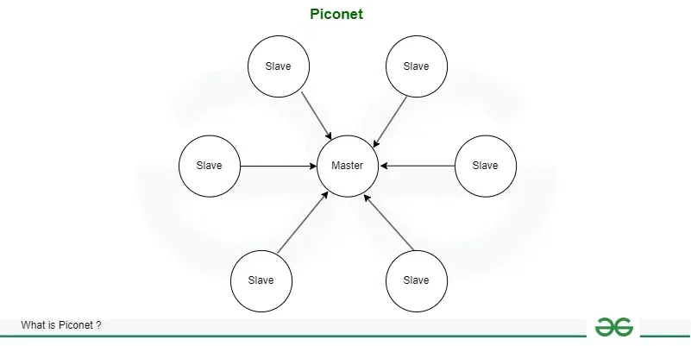
Architecture of Bluetooth
The architecture of Bluetooth defines two types of networks:
Piconet
Piconet is a type of Bluetooth network that contains one primary node called the master node and seven active secondary nodes called slave nodes. Thus, we can say that there is a total of 8 active nodes which are present at a distance of 10 meters.
The communication between the primary and secondary nodes can be one-to-one or one-to-many. Possible communication is only between the master and slave; Slave-slave communication is not possible. It also has 255 parked nodes, these are secondary nodes and cannot take participation in communication unless it gets converted to the active state.

Slide 15
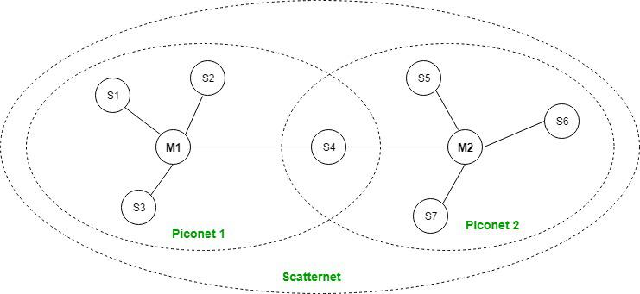
Scatternet
It is formed by using various piconets. A slave that is present in one piconet can act as master or we can say primary in another piconet. This kind of node can receive a message from a master in one piconet and deliver the message to its slave in the other piconet where it is acting as a master. This type of node is referred to as a bridge node. A station cannot be mastered in two piconets.

Slide 16
Bluetooth Protocol Stack
Radio (RF) Layer: It specifies the details of the air interface, including frequency, the use of frequency hopping and transmit power. It performs modulation/demodulation of the data into RF signals. It defines the physical characteristics of Bluetooth transceivers. It defines two types of physical links: connection-less and connection-oriented.
Baseband Link Layer: The baseband is the digital engine of a Bluetooth system and is equivalent to the MAC sublayer in LANs. It performs the connection establishment within a piconet, addressing, packet format, timing and power control.
Link Manager Protocol Layer: It performs the management of the already established links which includes authentication and encryption processes. It is responsible for creating the links, monitoring their health, and terminating them gracefully upon command or failure.
Logical Link Control and Adaption (L2CAP) Protocol Layer: It is also known as the heart of the Bluetooth protocol stack. It allows the communication between upper and lower layers of the Bluetooth protocol stack. It packages the data packets received from upper layers into the form expected by lower layers. It also performs segmentation and multiplexing.
Service Discovery Protocol (SDP) Layer: It is short for Service Discovery Protocol.It allows discovering the services available on another Bluetooth-enabled device.
RF Comm Layer: It is a cabal replacement protocol. It is short for Radio Frontend Component.It provides a serial interface with WAP and OBEX. It also provides emulation of serial ports over the logical link control and adaption protocol.
OBEX: It is short for Object Exchange. It is a communication protocol to exchange objects between 2 devices.
WAP: It is short for Wireless Access Protocol. It is used for internet access.
TCS: It is short for Telephony Control Protocol. It provides telephony service.
The basic function of this layer is call control (setup & release) and group management for the gateway serving multiple devices.
Application Layer: It enables the user to interact with the application.

Slide 17
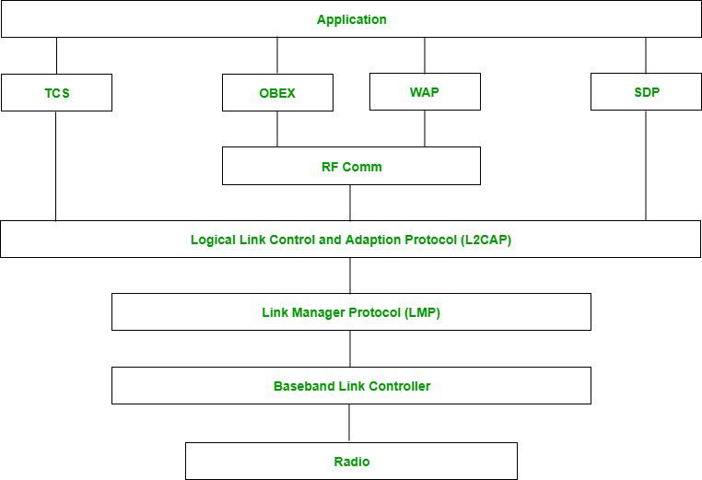
It enables the user to interact with the application.
Telephony Control Protocol.
Object Exchange.
Wireless Access Protocol.
Service Discovery Protocol
exchange objects between 2 devices.
used for internet access.
provides telephony service.
allows discovering the services available on another Bluetooth-enabled device.
provides a serial interface
heart of Stack segmentation and multiplexing.
authentication and encryption processes.
connection establishment within a piconet, addressing, packet format, timing and power control.
modulation/demodulation connectionless and connection-oriented.

Slide 18
Types of Bluetooth
Various types of Bluetooth are available in the market nowadays. Let us look at them.
In-Car Headset: One can make calls from the car speaker system without the use of mobile phones.
Stereo Headset: To listen to music in car or in music players at home.
Webcam: One can link the camera with the help of Bluetooth with their laptop or phone.
Bluetooth-Equipped Printer: The printer can be used when connected via Bluetooth with mobile phone or laptop.
Bluetooth Global Positioning System (GPS): To use Global Positioning System (GPS) in cars, one can connect their phone with car system via Bluetooth to fetch the directions of the address.
Applications of Bluetooth
It can be used in wireless headsets, wireless PANs, and LANs.
It can connect a digital camera wireless to a mobile phone.
It can transfer data in terms of videos, songs, photographs, or files from one cell phone to another cell phone or computer.
It is used in the sectors of Medical healthcare, sports and fitness, Military.
Advantages
It is a low-cost and easy-to-use device.
It can also penetrate through walls.
It creates an Ad-hoc connection immediately without any wires.
It is used for voice and data transfer.
Disadvantages
It can be hacked and hence, less secure.
It has a slow data transfer rate of 3 Mbps.
Bluetooth communication does not support routing.

Slide 19
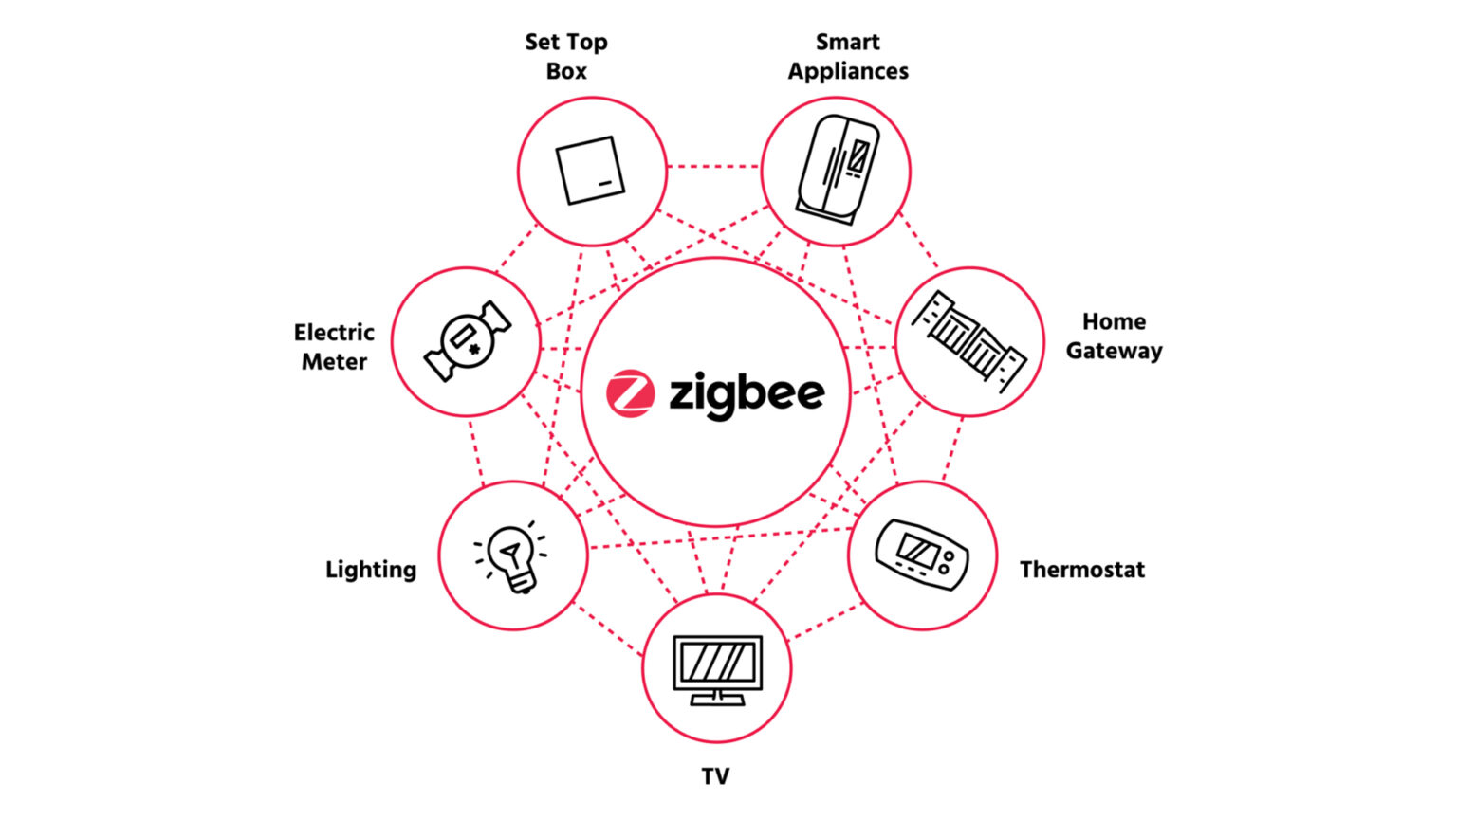
ZIGBEE

Slide 20
ZigBee is a Personal Area Network task group with low rate.
It is a technology of home networking.
ZigBee is a technological standard created for controlling and sensing the network.
As we know that ZigBee is the Personal Area Network so it is based on IEEE 802.15.4 and is created by Zigbee Alliance.
ZigBee is an open, global, packet-based protocol designed to provide an easy-to-use architecture for secure, reliable, low power wireless networks.
Flow or process control equipment can be placed anywhere and still communicate with the rest of the system. It can also be moved, since the network doesn't care about the physical location of a sensor, pump or valve.
ZigBee is a standard that addresses the need for very low-cost implementation of Low power devices with Low data rates for short-range wireless communications.
IEEE 802.15.4 supports star and peer-to-peer topologies.
The ZigBee specification supports star and two kinds of peer-to-peer topologies, mesh and cluster tree.
ZigBee-compliant devices are sometimes specified as supporting point-to-point and point-to-multipoint topologies.

Slide 21
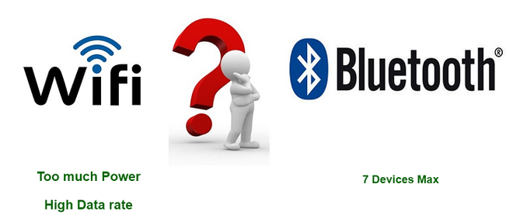
Why another short-range communication standard

Slide 22
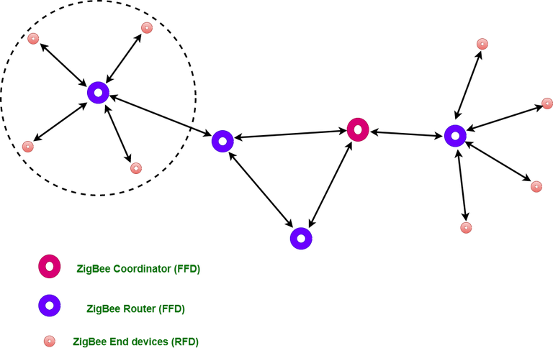
Types of ZigBee Devices:
Zigbee Coordinator Device: It communicates with routers.
This device is used for connecting the devices.
Zigbee Router: It is used for passing the data between devices.
Zigbee End Device: It is the device that is going to be controlled.
Zigbee Network Topologies
Star Topology (ZigBee Smart Energy): Consists of a coordinator and several end devices, end devices communicate only with the coordinator.
Mesh Topology (Self Healing Process): Mesh topology consists of one coordinator, several routers, and end devices.
Tree Topology: In this topology, the network consists of a central node which is a coordinator, several routers, and end devices. the function of the router is to extend the network coverage.

Slide 23
General Characteristics of Zigbee Standard
Low Power Consumption
Low Data Rate (20- 250 kbps)
Short-Range (75-100 meters)
Network Join Time (~ 30 msec)
Support Small and Large Networks (up to 65000 devices (Theory); 240 devices (Practically))
Low Cost of Products and Cheap Implementation (Open Source Protocol)
Extremely low-duty cycle.
3 frequency bands with 27 channels.
Operating Frequency Bands (Only one channel will be selected for use in a network):
Channel 0: 868 MHz (Europe)
Channel 1-10: 915 MHz (the US and Australia)
Channel 11-26: 2.4 GHz (Across the World)

Slide 24
Advantages of Zigbee
Designed for low power consumption.
Provides network security and application support services operating on the top of IEEE.
Zigbee makes possible completely networks homes where all devices are able to communicate and be
Use in smart home
Easy implementation
Adequate security features.
Low cost: Zigbee chips and modules are relatively inexpensive, which makes it a cost-effective solution for IoT applications.
Mesh networking: Zigbee uses a mesh network topology, which allows for devices to communicate with each other without the need for a central hub or router. This makes it ideal for use in smart home applications where devices need to communicate with each other and with a central control hub.
Reliability: Zigbee protocol is designed to be highly reliable, with robust mechanisms in place to ensure that data is delivered reliably even in adverse conditions.
Disadvantages of Zigbee
Limited range: Zigbee has a relatively short range compared to other wireless communications protocols, which can make it less suitable for certain types of applications or for use in large buildings.
Limited data rate: Zigbee is designed for low-data-rate applications, which can make it less suitable for applications that require high-speed data transfer.
Interoperability: Zigbee is not as widely adopted as other IoT protocols, which can make it difficult to find devices that are compatible with each other.
Security: Zigbee's security features are not as robust as other IoT protocols, making it more vulnerable to hacking and other security threats.

Slide 25
Zigbee Applications
Home Automation
Medical Data Collection
Industrial Control Systems
meter reading system
light control system
Commercial
Government Markets Worldwide
Home Networking

Slide 26
Wireless HART -Highway Addressable Remote Transducer
As the need for additional process measurements increases, users seek a simple, reliable, secure and cost-effective method to deliver new measurement values to control systems without the need to run more wires. With process improvements, plant expansions, regulatory requirements and safety levels demands for additional measurements, users are looking to wireless technology for that solution.
With approximately 30 million HART devices installed and in service worldwide, HART technology is the most widely used field communication protocol for intelligent process instrumentation. With the additional capability of wireless communication, the legacy of benefits this powerful technology provides continues to deliver the operational insight users need to remain competitive.
HART is a communication protocol used in industrial instrumentation that allows digital communication over the same wires used for analog (4–20 mA) signals.
Traditional systems send only analog signals (4–20 mA)
HART adds digital data on top of analog signal
Both travel on the same two wires

Slide 27
2️⃣ Why WirelessHART was developed
Traditional HART:
Needs wiring Expensive to install in large plants
Hard to add new instruments WirelessHART solves this by: ✅ Eliminating cables ✅ Reducing installation cost ✅ Allowing easy expansion
Think of it like this 🎵:
Analog signal = road
Digital signal = small vibration on the road Vehicles (analog value) move normally
Vibrations (digital data) carry extra information
Control system sees correct 4–20 mA
HART system reads digital information

Slide 28
WirelessHART Architecture (Easy Explanation)
1. Wireless Field Devices
Sensors: pressure, temperature, flow, level
Battery powered
Measure process variables
Also act as routers in the network
2. Wireless Mesh Network
Devices communicate with each other
Data hops device → device → gateway
If one path fails, another path is used
3. WirelessHART Gateway
Central communication point
Collects data from all field devices
4. Network Manager
Usually inside the gateway
Assigns:
Communication paths,Time slots,Security keys
Optimizes network performance
5. Host / Control System
Displays measurements
Performs monitoring and diagnostics
Limited control (not fast control loops)
🔁 Data Flow (one line)
Field Device → Mesh Network → Gateway → Control System

Slide 29
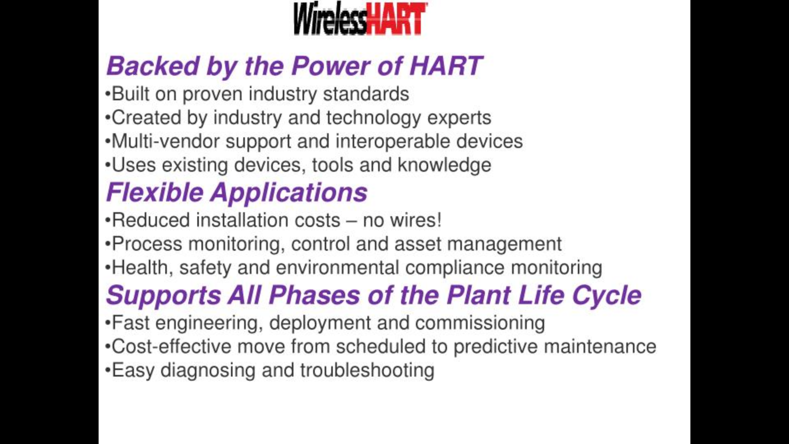

Slide 30
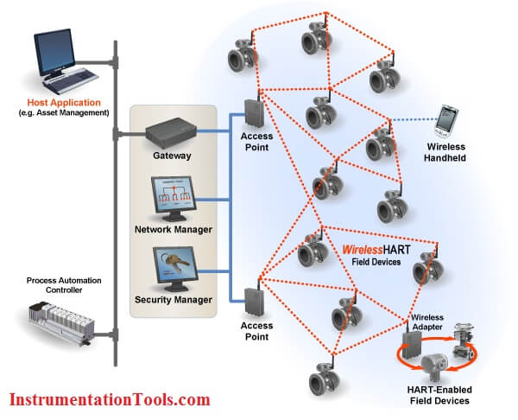
6. Access Points
Provide wireless connection between:
Gateway
Field device network
Extend coverage area
Multiple access points improve reliability
3. Gateway (Very Important)
Acts as a bridge between:
WirelessHART network
Wired control system
Collects data from all wireless devices
Sends data to host system
👉 Without gateway, WirelessHART cannot talk
1. Host Application
Runs on a computer
Displays:
Used by operators & maintenance engineers
📌 Example: AMS, SCADA, DCS software
8. Wireless Handheld
Used for:
Configuration
Calibration
Diagnostics
Can join the network temporarily
Acts as secondary master
4. Network Manager
Manages:
Routing paths & Time slots & Communication schedules
Ensures: Reliable delivery & Self-healing mesh
9. Wireless Adapter (Bottom right)
Converts existing wired HART device into wireless
Used when replacing devices is expensive
Saves cost
2. Process Automation Controller
Performs control logic
Receives data from WirelessHART gateway Mainly for monitoring, not fast control
5. Security Manager
Handles network security
Distributes: Encryption keys Authentication credentials
👉 Prevents unauthorized access.
7. WirelessHART Field Devices
Sensors (pressure, flow, temperature, level)
Battery powered
Communicate wirelessly
Also act as routers in the mesh network

Slide 31
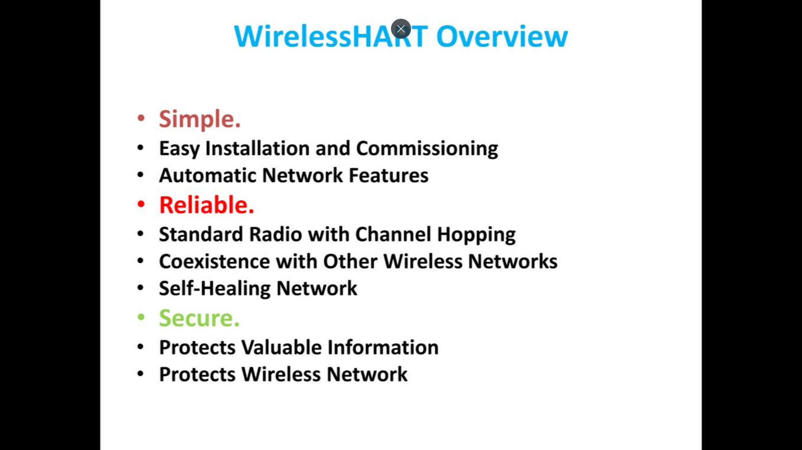

Slide 32
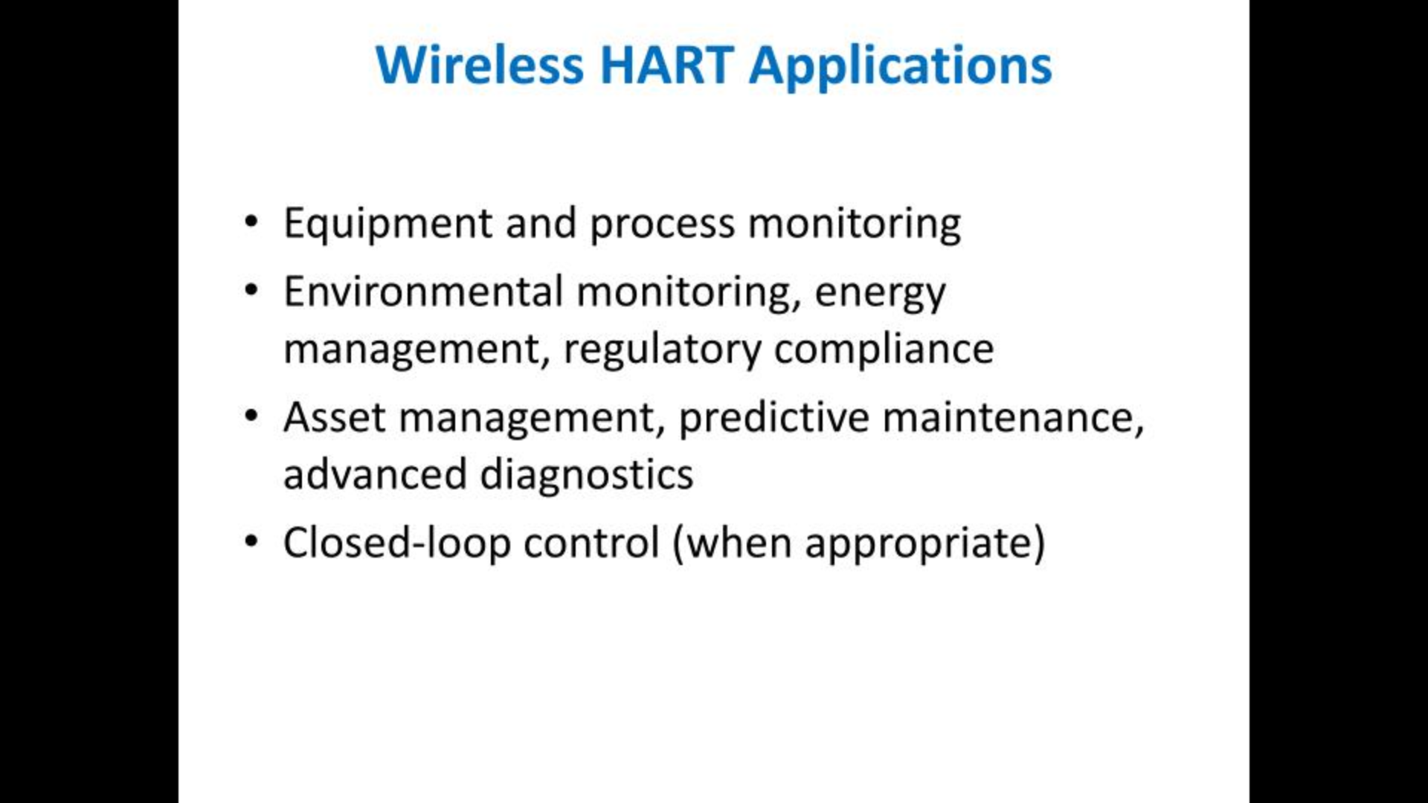

Slide 33
Feature | WirelessHART
Standard | IEC 62591
Frequency band | 2.4 GHz (ISM band)
Data rate | 250 kbps
Topology | Mesh
Power | Battery-powered
Security | AES-128 encryption

Slide 34
Feature | Wired HART | WirelessHART
Medium | Cable | Radio
Wiring cost | High | Very low
Installation | Difficult | Easy
Mobility | No | Yes
Power | Loop powered | Battery powered

Slide 35
Z-Wave is a wireless communication protocol known for Home Automation. Wireless Communication protocol is simply a set of rules or some standards, an application, or a program that should be followed in order to communicate wirelessly. This wireless protocol allows multiple wireless devices to communicate with each other in an affordable and reliable way with easy-to-use smart products.
History of Z-Wave
Z-wave was first developed/founded by the two Danish engineers of a start-up company named, Zensys. Their actual motive was to build something to automate homes, but this later turned out to be a protocol implemented by many companies all over the world.
Later in 2008, it was acquired by Sigma Designs. After seeing the potential of this technology, many other companies( such as Z-Wave Russia, z wave Sverige ADI, Samsung SDS, Vivint, D-Link, and many other companies) also joined the alliance, which is formerly known as Z-Wave Alliance.
Currently Z-Wave: It currently has more than 300 companies, with more than 500+ devices that support 14 Million applications worldwide.
Z-Wave is NOT industrial like HART. It is mainly used in:
🏠 Smart homes
🏢 Smart buildings

Slide 36
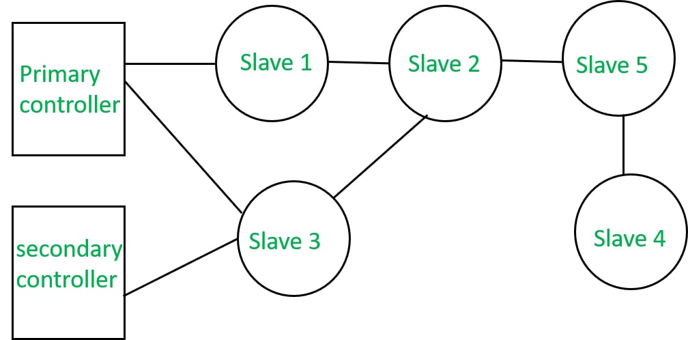

Slide 37
Z-Wave Components :
The components of z-wave include controllers, slave nodes, Home ID, Node ID, and routing tables.
Controllers: A controller is a unit that has the ability to compile a routing table of the network and can calculate routes to the different nodes. There are two types of controllers -
Primary controller: Primary controller is the device that contains a description of the z-wave network and controls the output. It assigns network ID or Home ID or Node ID to the z-wave during the enrollment process.
Secondary controller: It also has a Network ID and it remains constant to maintain routing tables.
Slave nodes: Slave nodes are the nodes that do not contain routing tables but may contain a network map. slave nodes have the ability to receive frames and respond to them if necessary.
Home ID: The ID used by z-Wave for the separation of the network from each other is called Home ID. It is created by the primary controller and is 32-bit in size.
Node ID: The identification number or an address that is given to every device during the process of inclusion is called Node ID.
Routing table: It is used by controllers for calculating routes.

Slide 38
Feature | Z-Wave
Frequency | ~900 MHz (sub-GHz)
Range | 30–100 meters
Data rate | Up to 100 kbps
Topology | Mesh
Power | Battery powered
Max devices | 232 per network
Applications of Z-Wave :
Home automation
Water management using flood sensors
Fingerprint scanner

Slide 39
Network Layer Protocol

Slide 40
Network Layer is responsible for the transmission of data or communication from one host to another host connected in a network. Rather than describing how data is transferred, it implements the technique for efficient transmission. In order to provide efficient communication protocols are used at the network layer. The data is being grouped into packets or in the case of extremely large data it is divided into smaller sub packets. Each protocol used has specific features and advantages. The below article covers in detail the protocols used at the network layer.
Functions of Network Layer
The network layer is responsible for providing the below-given tasks:
Logical Addressing: Each device on the network needs to be identified uniquely. Therefore network layer provides an addressing scheme to identify the device. It places the IP address of every sender and the receiver in the header. This header consists of the network ID and host ID of the network.
Host-to-host Delivery of Data: The network layer ensures that the packet is being delivered successfully from the sender to the receiver. This layer makes sure that the packet reaches the intended recipient only.
Fragmentation: In order to transmit the larger data from sender to receiver, the network layer fragments it into smaller packets. Fragmentation is required because every node has its own fixed capacity for receiving data.
Congestion Control: Congestion is defined as a situation where the router is not able to route the packets property which results in aggregation of packets in the network. Congestion occurs when a large amount of packets are flooded in the network. Therefore network layer controls the congestion of data packets in the network.
Routing and Forwarding: Routing is the process that decides the route for transmission of packets from sender to receiver. It mostly chooses the shortest path between the sender and the receiver. Routing protocols that are mostly used are path vector, distance vector routing, link state routing, etc.

Slide 41
nternet Protocol Version 4 (IPv4)
IPv4 is 32-bit addressing scheme used as TCP/IP host addressing mechanism. IP addressing enables every host on the TCP/IP network to be uniquely identifiable.
IPv4 provides hierarchical addressing scheme which enables it to divide the network into sub-networks, each with well-defined number of hosts. IP addresses are divided into many categories:
Class A - it uses first octet for network addresses and last three octets for host addressing
Class B - it uses first two octets for network addresses and last two for host addressing
Class C - it uses first three octets for network addresses and last one for host addressing
Class D - it provides flat IP addressing scheme in contrast to hierarchical structure for above three.
Class E - It is used as experimental.
IPv4 also has well-defined address spaces to be used as private addresses (not routable on internet), and public addresses (provided by ISPs and are routable on internet).
Though IP is not reliable one; it provides Best-Effort-Delivery mechanism.
Internet Protocol Version 6 (IPv6)
Exhaustion of IPv4 addresses gave birth to a next generation Internet Protocol version 6. IPv6 addresses its nodes with 128-bit wide address providing plenty of address space for future to be used on entire planet or beyond.
IPv6 has introduced Anycast addressing but has removed the concept of broadcasting. IPv6 enables devices to self-acquire an IPv6 address and communicate within that subnet. This auto-configuration removes the dependability of Dynamic Host Configuration Protocol (DHCP) servers. This way, even if the DHCP server on that subnet is down, the hosts can communicate with each other.
IPv6 provides new feature of IPv6 mobility. Mobile IPv6 equipped machines can roam around without the need of changing their IP addresses.
IPv6 is still in transition phase and is expected to replace IPv4 completely in coming years. At present, there are few networks which are running on IPv6. There are some transition mechanisms available for IPv6 enabled networks to speak and roam around different networks easily on IPv4. These are:
Dual stack implementation
Tunneling
NAT-PT

Slide 42
IPv4 (Internet Protocol version 4) operates at the Network Layer (Layer 3) of the OSI model and at the Internet Layer of the TCP/IP model. Its primary role is to provide logical addressing and routing so that packets can travel from a source host to a destination host across interconnected networks.
At this layer, IPv4 is responsible for:
Identifying devices using a unique 32-bit IP address.
Determining the best path for data packets through routers.
Encapsulating transport layer segments into IP packets with headers containing routing and control information.
Key IPv4 Characteristics
Address Format: 32-bit, written in dotted-decimal notation (e.g., 192.168.0.1).
Header Size: Minimum 20 bytes, containing fields like Version, Header Length, TTL, Protocol, Source/Destination IP.
Addressing Modes: Unicast (one-to-one), Broadcast (one-to-all), Multicast (one-to-many).
Routing: Uses forwarding tables in routers for hop-by-hop delivery.
TTL (Time To Live): Prevents packets from looping indefinitely.

Slide 43
6LoWPAN stands for IPv6 over Low-Power Wireless Personal Area Networks. It’s a communication protocol designed to enable small, low-power devices to connect over wireless networks. In this article, we will discover everything about 6LoWPAN and its various advantages and disadvantages.
What is 6LoWPAN?
6LoWPAN is an IPv6 protocol, and It's extended from IPv6 over Low Power Personal Area Network. As the name itself explains the meaning of this protocol is that this protocol works on Wireless Personal Area Network. WPAN is a Personal Area Network (PAN) where the interconnected devices are centered around a person’s workspace and connected through a wireless medium. You can read more about WPAN at WPAN. 6LoWPAN allows communication using the IPv6 protocol. IPv6 is Internet Protocol Version 6 is a network layer protocol that allows communication to take place over the network. It is faster and more reliable and provides a large number of addresses.
6LoWPAN initially came into existence to overcome the conventional methodologies that were adapted to transmit information. But still, it is not so efficient as it only allows for the smaller devices with minimal processing ability to establish communication using one of the Internet Protocols, i.e., IPv6. It has very low cost, short-range, low memory usage, and low bit rate. It comprises an Edge Router and Sensor Nodes. Even the smallest of the IoT devices can now be part of the network, and the information can be transmitted to the outside world as well. For example, LED Streetlights.
It is a technology that makes the individual nodes IP-enabled. 6LoWPAN can interact with 802.15.4 devices and also other types of devices on an IP Network. For example, Wi-Fi. It uses AES 128 link layer security, which AES is a block cipher having key size of 128/192/256 bits and encrypts data in blocks of 128 bits each. This is defined in IEEE 802.15.4 and provides link authentication and encryption.

Slide 44
Basic Requirements of 6LoWPAN
The device should be having sleep mode in order to support the battery saving.
Minimal memory requirement.
Routing overhead should be lowered.
Features of 6LoWPAN
It is used with IEEE 802.15,.4 in the 2.4 GHz band.
Outdoor range: ~200 m (maximum)
Data rate: 200kbps (maximum)
Maximum number of nodes: ~100
Advantages of 6LoWPAN
6LoWPAN is a mesh network that is robust, scalable, and can heal on its own.
It delivers low-cost and secure communication in IoT devices.
It uses IPv6 protocol and so it can be directly routed to cloud platforms.
It offers one-to-many and many-to-one routing.
In the network, leaf nodes can be in sleep mode for a longer duration of time.
Disadvantages of 6LoWPAN
It is comparatively less secure than Zigbee.
It has lesser immunity to interference than that Wi-Fi and Bluetooth.
Without the mesh topology, it supports a short range.

Slide 45
Applications of 6LoWPAN
It is a wireless sensor network.
It is used in home-automation,
It is used in smart agricultural techniques, and industrial monitoring.
It is utilised to make IPv6 packet transmission on networks with constrained power and reliability resources possible.
Security and Interoperability with 6LoWPAN
Security: 6LoWPAN security is ensured by the AES algorithm, which is a link layer security, and the transport layer security mechanisms are included as well.
Interoperability: 6LoWPAN is able to operate with other wireless devices as well which makes it interoperable in a network.

Slide 46
4. Icmp
ICMP Stands For Internet Control Message Protocol. ICMP Is A Part Of IP Protocol Suite. ICMP Is An Error Reporting And Network Diagnostic Protocol. Feedback In The Network Is Reported To The Designated Host. Meanwhile, If Any Kind Of Error Occur It Is Then Reported To ICMP. ICMP Protocol Consists Of Many Error Reporting And Diagnostic Messages. ICMP Protocol Handles Various Kinds Of Errors Such As Time Exceeded, Redirection, Source Quench, Destination Unreachable, Parameter Problems Etc. The Messages In ICMP Are Divided Into Two Types. They Are Given Below:
Error Message: Error Message States About The Issues Or Problems That Are Faced By The Host Or Routers During Processing Of IP Packet.
Query Message: Query Messages Are Used By The Host In Order To Get Information From A Router Or Another Host.
How Does ICMP Work?
The Main And Most Significant Protocol In The Ip Suite Is Called Icmp. However, Unlike TCP And UDP, ICMP Is A Connectionless Protocol, Meaning It Doesn't Require A Connection To Be Established With The Target Device In Order To Transmit A Message.
Tcp And Icmp Operate Differently From One Another; Tcp Is A Connection-oriented Protocol, While Icmp Operates Without A Connection. Every Time A Connection Is Made Prior To A Message Being Sent, A TCP Handshake Is Required Of Both Devices.
Datagrams Including An Ip Header Containing Icmp Data Are Used To Transmit Icmp Packets. An Independent Data Item Like A Packet Is Comparable To An ICMP Datagram.
Internet Control Message Protocol (ICMP)
ICMP Is Network Diagnostic And Error Reporting Protocol. ICMP Belongs To IP Protocol Suite And Uses IP As Carrier Protocol. After Constructing ICMP Packet, It Is Encapsulated In IP Packet. Because IP Itself Is A Best-effort Non-reliable Protocol, So Is ICMP.
Any Feedback About Network Is Sent Back To The Originating Host. If Some Error In The Network Occurs, It Is Reported By Means Of ICMP. ICMP Contains Dozens Of Diagnostic And Error Reporting Messages.
Icmp-echo And Icmp-echo-reply Are The Most Commonly Used Icmp Messages To Check The Reachability Of End-to-end Hosts. When A Host Receives An Icmp-echo Request, It Is Bound To Send Back An Icmp-echo-reply. If There Is Any Problem In The Transit Network, The ICMP Will Report That Problem.

Slide 47
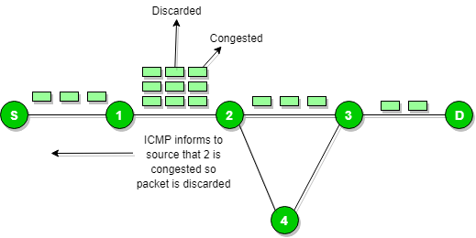

Slide 48
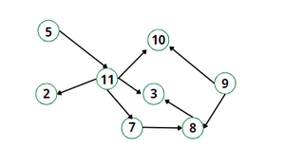
What Is RPL (Ipv6 Routing Protocol)?
RPL Stands For Routing Protocol For Low Power And Lossy Networks For Heterogeneous Traffic Networks. It Is A Routing Protocol For Wireless Networks. This Protocol Is Based On The Same Standard As By Zigbee And 6 Lowpan Is IEEE 802.15.4 It Holds Both Many-to-one And One-to-one Communication.
It Is A Distance Vector Routing Protocol That Creates A Tree-like Routing Topology Called The Destination Oriented Directed Acyclic Graph (Dodag), Rooted Towards One Or More Nodes Called The Root Node Or Sink Node.
The Directed Acyclic Graphs (DAGs) Are Created Based On User-specified Specific Objective Function (Of). The OF Defines The Method To Find The Best-optimized Route Among The Number Of Sensor Devices.

Slide 49
The IETF chartered the ROLL (Routing Over Low power and Lossy networks) working group to evaluate all three routing protocols and determine the needs and requirements for developing a routing solution for IP smart objects. After the study of various use cases and a survey of existing protocols, the consensus was that a new routing protocol should be developed for IP smart objects, given the characteristics and requirements of the constrained network. This new Distance Vector Routing Protocol was named the IPv6 Routing Protocol for Low power and Lossy networks(RPL). The RPL specification was published as RFC 6550 by the ROLL working group.
In an RPL Network, each node acts as a router and becomes part of a mesh network. Routing is performed at the IP Layer. Each node examines every received IPv6 packet and determines the next-hop destination based on the information contained in the IPv6 header. No information from the MAC layer header is needed to perform the next determination.

Slide 50
Modes of RPL:
This protocol defines two modes:
1. Storing mode
All modes contain the entire routing table of the RPL domain. Every node knows how to reach every other node directly.
2. Non-Storing mode
Only the border router(s) of the RPL domain contain(s) the full routing table. All other nodes in the domain maintain their list of parents only and use this as a list of default routes towards the border router. The abbreviated routing table saves memory space and CPU. When communicating in non-storing mode, a node always forwards its packet to the border router, which knows how to ultimately reach the final destination.
RPL is based on the concept of a Directed Acyclic Graph (DAG). A DAG is Directed Graph where no cycle exists. This means that from any vertex or point in the graph, we cannot follow an edge or a line back to this same point. All of the edges are arranged in a path oriented toward and terminating at one or more root nodes.
A basic RPL process involves building a Destination Oriented Directed Acyclic Graph (DODAG). A DODAG is a DAG rooted in one destination. In RPL this destination occurs at a border router known as the DODAG root. In a DODAG, three parents maximum are maintained by each node that provides a path to the root. Typically one of these parents is the preferred parent, which means it is the preferred next hop for upward roots towards the root. The routing graph created by the set of DODAG parents across all nodes defines the full set of upwards roots. RPL protocol information should ensure that routes are loop-free by disallowing nodes from selected DODAG parents positioned further away from a border router.

Slide 51
Main Features and Advantages of RPL
The IPv6 Routing Protocol for RPL, is an efficient and effective protocol for data routing in resource-constrained scenarios, such Internet of Things devices as per requirement. Its many essential features include the below points:
Scalability: The protocol can accommodate such type of big networks with low power and lossy connectivity, which makes it appropriate for a range of Internet of Things applications.
Multipoint-to-point traffic generation: RPL offers a way to send data to a single destination point from several devices within the LLN as per requirement.
Quality of Service (QoS) - The protocol guarantees QoS by offering various types of methods for reliable packet delivery system and congestion control systetm.
Adaptive – RPL modifies the required routes in response to link quality and energy availability changes in the network environment or system.
Security system: To guarantee various types of secure communication within the LLN as per requirement, RPL incorporates techniques for integrity protection, authentication, confidentiality, and encryption for better performance.

Slide 52
Application Layer

Slide 53
The Constrained Application Protocol (CoAP) is a special web transfer protocol that operates with constrained nodes and networks. These networks are commonly used for applications such as the Internet of Things (IoT), where devices may have limited processor, memory, and power resources. CoAP is intended to be simple, low-overhead, and efficient, making it ideal for machine-to-machine communication.
What is CoAP?
CoAP or Constrained Application Protocol, as the name suggests, is an application layer protocol that was introduced by the Internet Engineering Task Force in the year 2014. CoAP is designed for the constrained environment. It is a web-based protocol that resembles HTTP. It is also based on the request-response model. Based on the REST-style architecture, this protocol considers the various objects in the network as resources. These resources are uniquely assigned a URI or Uniform Resource Identifier. The data from one resource to another resource is transferred in the form of CoAP message packets whose format is briefly described later. The Client requests for some resources and in response to that, the server sends some response over which the client sends an acknowledgement. Although, some types of CoAP do not involve the receiver sending acknowledgments for the information received.

Slide 54
How Does CoAP Works?
Constrained Application Protocol (CoAP) is an application layer protocol designed for resource-constrained devices and networks, particularly in the context of the Internet of Things (IoT).
Client-Server Model: CoAP model is essentially a client/server model enabling the client to request for service from server as needed and the server responds to client's request.
Resource-Oriented: CoAP treats various objects in the network as resources, each uniquely identified by a URI (Uniform Resource Identifier). Clients can request information about these resources, and servers provide responses2.
Methods: CoAP supports several methods similar to HTTP:
GET
POST
DELETE
PUT
Asynchronous Messaging: CoAP messages are asynchronous because it uses the User Datagram Protocol (UDP). Unlike TCP-based protocols, CoAP does not require acknowledgments for every message, which helps conserve energy in resource-constrained devices.
Energy Efficiency: CoAP is designed to minimize energy consumption while simplifying communication between clients and devices. It achieves this by managing resources, providing device descriptions, and supporting mechanisms to determine if a device is powered on or off.

Slide 55
Methods in CoAP
GET - The get method is used to retrieve resource information identified by the request URI. In response to GET method success a 200(OK) response is sent.
POST - The post method creates a new subordinate resource under the parent URI requested by it to the server. On successful resource creation on the server, a 201 (Created) response is sent while on failure a 200 (OK) response code is sent.
DELETE - The delete method deletes the resource identified by the requested URI and a 200 (OK) response code is sent on successful operation.
PUT - The PUT method updates or creates the resource identified by the request URI with the enclosed message body. The message body is considered as modified version of a resource if it already exists at the specified URI otherwise a new resource with that URI is created. A 200 (OK) response is received in former case whereas a 201 (Created) response is received in later case. If the resource is neither created nor modified then an error response code is sent.
The most fundamental difference between CoAP and HTTP is that CoAP defines a new method which is not present in HTTP. This method is called Observe method. The observe method is very similar to the GET method in addition with an observe option. This alerts the server, to send every update about the resource to the client. Therefore, upon any change in the resource, the server sends a response to the client. These responses could either be directly sent individually or they can be piggy-backed.

Slide 56
Message Format of CoAP
CoAP messages are encoded in binary-format or 0/1 format. Like other message formats, CoAP message has a header and a payload section along with an optional section. The size of CoAP header is 4 bytes or 32 bits. This size is fixed for every CoAP message. Whereas the other part of message is the optional part which includes payload and tokens of variable size ranging from 0-8 bytes. The message format of CoAP contains the following fields:
Version - The size of version field is 2 bits. It represents the version of the CoAP protocol.
Type Code - The size of type field is 2 bits. There are four types of messages namely confirmable, non-confirmable, acknowledgement and reset represented by the bit patterns 00, 01, 10, 11 respectively.
Option Count - The size of option count field is 4 bits. These 4 bits, means there could be a total of 16 possible options in header.
Code - The size of code field is 8 bits. This indicates whether message is empty, request message or response message.
Message ID - The size of message ID field is 16 bits. It is used to detect the message duplication and types of messages.
Tokens [Optional] - The size of tokens field is variable which ranges from 0-8 bytes. It's used to match a response with request.
Options [Optional] - The options field in CoAP message has a variable size. It defines the type of payload message.
Payload [Optional] - Similar to options field, the payload field has a variable size. The payload of requests or of responses is typically a representation of the requested resource or the result of the requested action.

Slide 57
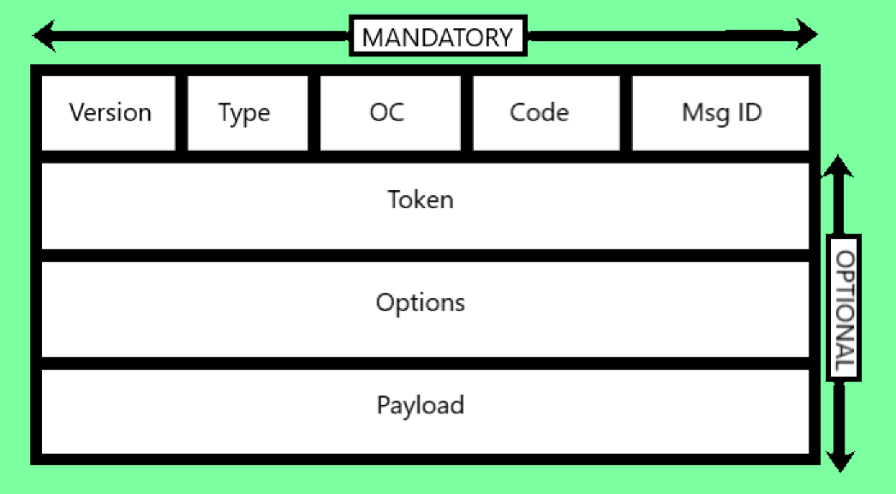

Slide 58
CoAP Features
Lightweight and Simple
RESTful Architecture
UDP-Based
Asynchronous Communication
Low Header Overhead
Multicast Communication
Proxy and Caching
Applications of CoAP
Real Time Monitoring in Grid - Smart cities can monitor the distribution and generation of power remotely. The CoAP sensors could be embedded inside the transformers and the data could be transferred over GPRS or 6LowPAN.
Defense utilities - The armory and tanks are now-a-days fitted with sensors so that information could be communicated remotely without any interference. The CoAP sensors could detect any intrusion. This makes them capable to transfer more data even under low bandwidth network.
Aircraft utilities - The Aircraft sensors and actuators could be connected with other sensors and communication can take place using smart CoAP based sensors and actuators.

